Slide 1
Corrective Action Review for Calibration Meeting (May, 2014)
Team B:
Jim Carlisle, John Carlin and Rebeca Navarrete

Slide 2
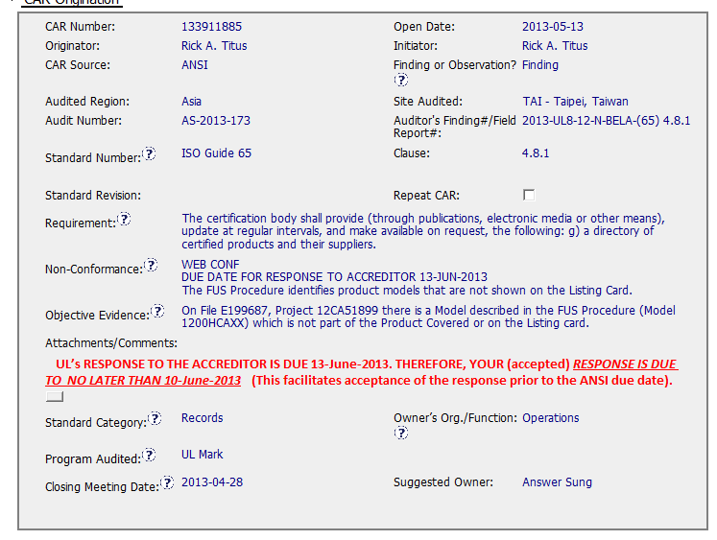
CAR 133911885 – Exemplary CAR

Slide 3
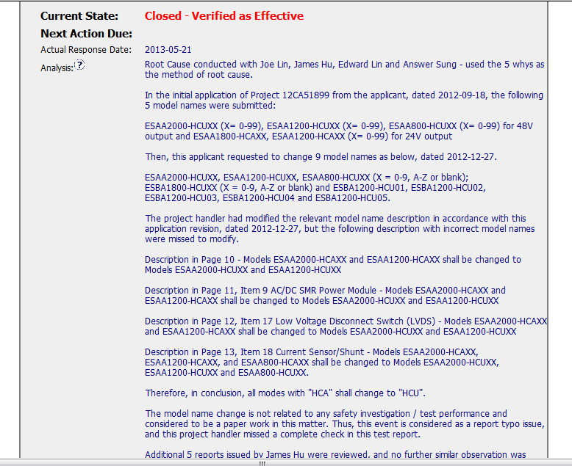
CAR 133911885 – Exemplary CAR

Slide 4
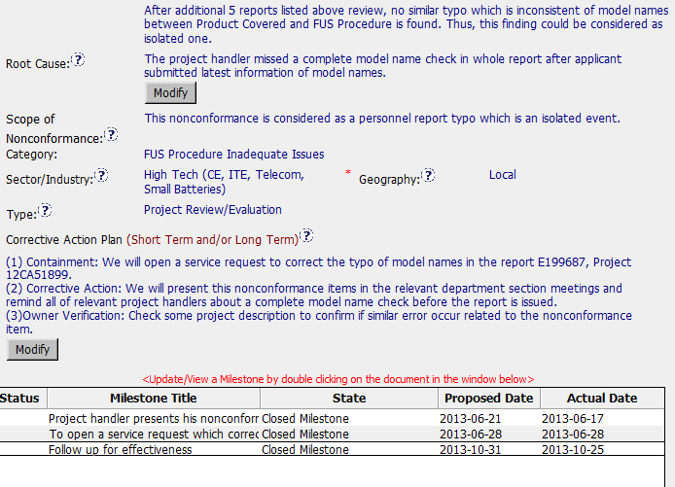
CAR 133911885 – Exemplary CAR

Slide 5
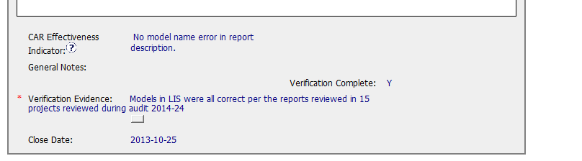
CAR 133911885 – Exemplary CAR

Slide 6
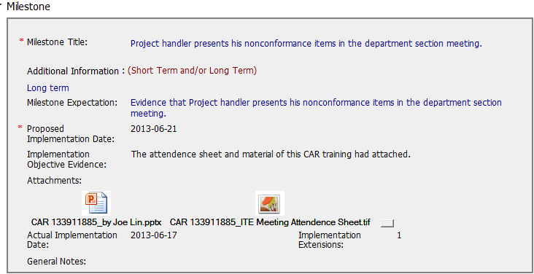
CAR 133911885 – Exemplary CAR

Slide 7
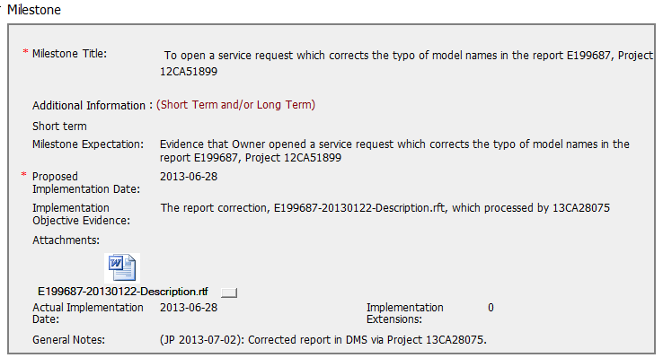
CAR 133911885 – Exemplary CAR

Slide 8
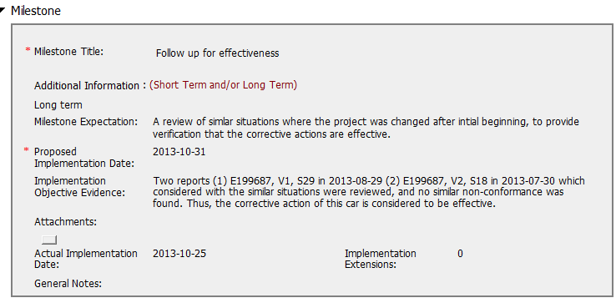
CAR 133911885 – Exemplary CAR

Slide 9
CAR 133911885 – Exemplary CAR
Comments:
1) The Analysis includes all stakeholders included in the analysis;
2) The 5 Why tool was used as part of the analysis; Other projects were reviewed for the same issue identified.
3) The true root cause was identified;
4) Corrective actions included containment, corrective actions, and verification steps.
5) There was sufficient time between corrective actions and owners verification to allow more projects of a similar nature to be completed prior to owner’s verification.

Slide 10
CAR 133911885 – Exemplary CAR
INTEGRITY: Initiative & Decision Making / Analyzing & Problem Solving
Facilitates progression of the CAR through closure: extensions, escalations, reassignments, etc. (+)
Accurately completes the administrative fields within the CAR such as root cause category, process impacted, geography, etc. (+)
Acts on CARs within the required timeframe (+)
Most appropriate ‘category’, ‘type (+)

Slide 11
CAR 133911885 – Exemplary CAR
COMPETIVENESS: Customer Focus / Achieve Business Results / Flexibility
Assists customers as they address all aspects of the CAR – analysis, root cause statement, milestone, containment, verification, etc. (+)
Verifies CARs timely (+)
(C) Analysis shows clear path to root cause and scope; stakeholders identified (+)
(C) Root cause statement is succinct, reasonable, complete (+)
(C) Corrective actions fix the objective evidence and other problems found; address entire root cause and scope. (+)
(C) Milestones address containment & owner’s verification; completed per milestone expectations (+)
(P) Verification per requirements (+)
COLLABORATION: Leading & Engaging / Teamwork / Communication
Provides pertinent feedback at appropriate times; shares information and keeps others informed (+)

